Slide 1
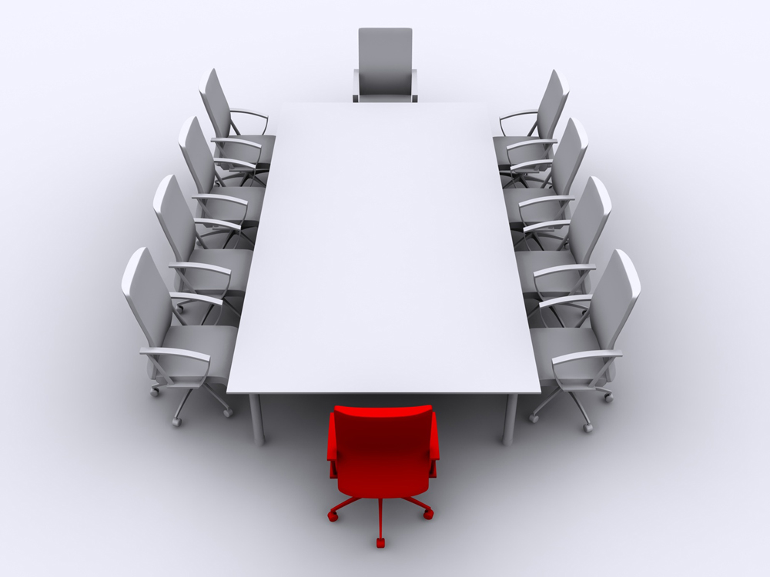
Effective Meetings
Deborah Walsh
July 16, 2011

Slide 2
Your Choice

Slide 3
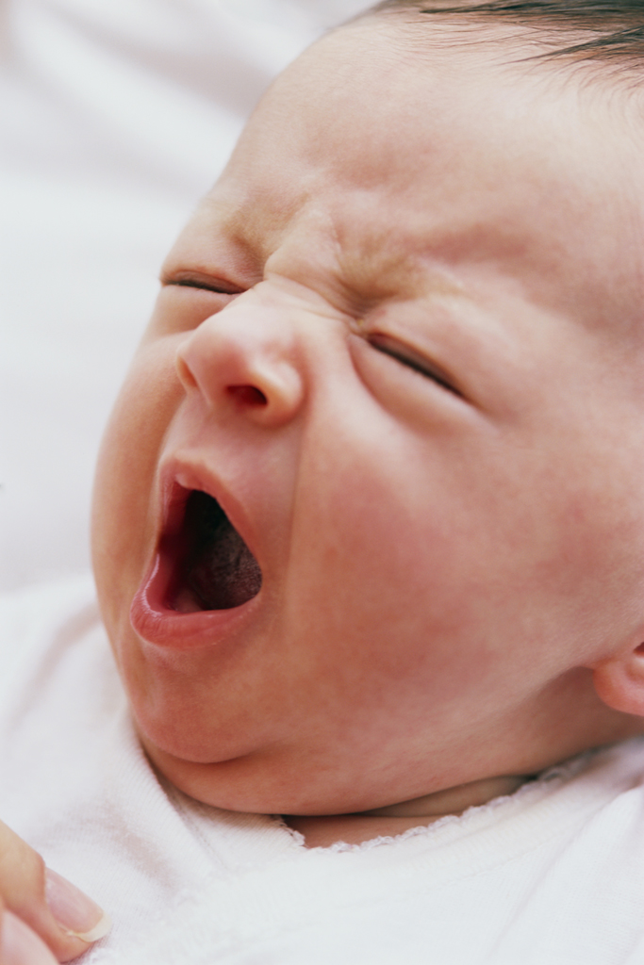
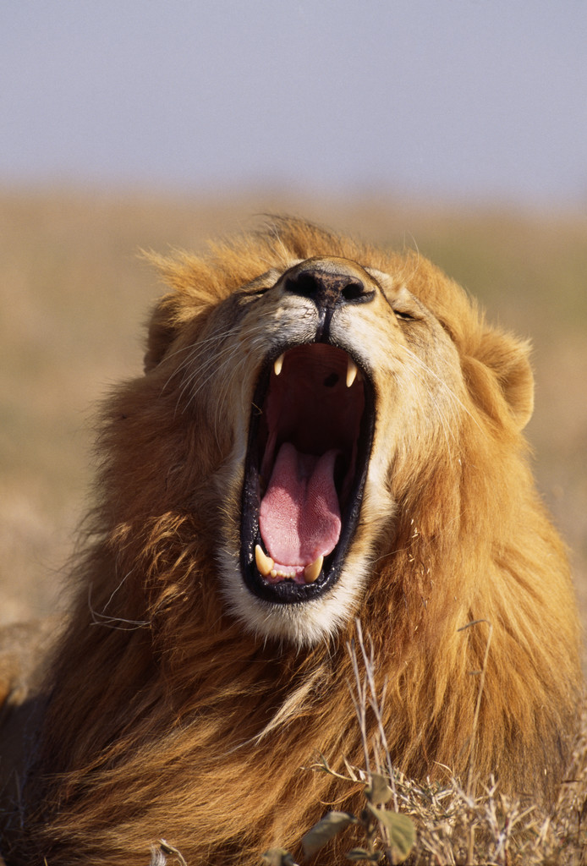
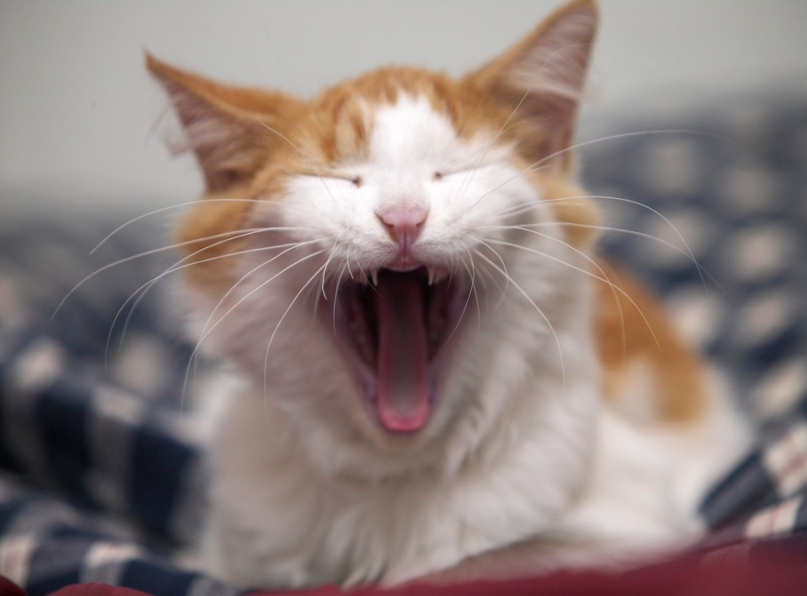

Slide 4
OR

Slide 5
Good Meetings….
happen when every board member knows he/she is responsible;
begin before the meeting convenes;
follow established rules;
stick the agenda;
occur when attendees know how to move things along; and
become even better through evaluation.
Good meetings happen when the Chair knows how to facilitate.

Slide 6
What’s a Board (any board member) Member to do?
Prepare well.
Take part in discussions.
Do whatever is necessary to cooperate and make meetings work.
Understand basic parliamentary procedure.
Learn the art of compromise.
Learn the art of listening.
Work towards consensus.
Focus deliberations on mission and goals.

Slide 7
Before the meeting: Preparation is the key
Reports
Background Info
Request for agenda items
Is this meeting necessary?
Read & research
Formulate questions
Ask for more information
FACILITATOR
BOARD MEMBER

Slide 8
Establish and Follow Rules
GROUND RULES establish a norm for boards.
2 minutes;
Talk to facilitator, not to each other. No one-on-one arguing.
Treat with respect.
No one dominates.
No one speaks again until all others have spoken.
Everyone gets a turn.
Timed debate.
ROBERT’S RULES…can work for your group.
All are welcome; minority gets heard; majority rules

Slide 9
Establish rules
Facilitate creation of Ground Rules.
Remind board of ground rules prior to start of meeting.
Understand Robert’s Rules and use them with humor and an eye toward assisting.
Ensure quorum present.
Participate in discussion of Ground Rules.
Remember them and cooperate at meetings.
Understand Robert’s Rules and participate in debate using them.
Faciliator
Board Members

Slide 11
Agenda: the road to an effective meeting.
Timed agendas
Ground Rules
Timers/Self-Policing
Facilitate with grace….
“We’re getting close to our deadline…does anyone want to add anything that we haven’t discussed before we vote?”
“Time is running out. Are you ready for a vote?”
“We know you have more to say, but there are others waiting. Let’s give them a chance before time runs out.”

Slide 13
Agenda: the road to an effective meeting
Consent Agenda
Minutes
Reports
Correspondence
Items can be removed from consent agenda for discussion via request, no second necessary

Slide 14
Sample Meeting Agenda containing Consent Agenda
7PM Call to Order, attendance, ground rules, and consent agenda:
Minutes of 5/3/11, 6/10/11, 7/12/11 meetings
Reports: Board of Ed Liaison, Hospitality Committee, Teacher Rep, Spring Fair Committee final report.
Proposed thank-you letter to 2010-11 volunteers sent on behalf of board.
Proposed invitation to teachers to join PTA in 2011-12 school year, sent on behalf of the board.
7:05 Reports:
Bylaws Committee
Fundraising Committee

Slide 15
Agenda
Reasonable timing
Ground Rules reminder
Consent agenda
Facilitate with grace
Explain and allow for changes of consent agenda items.
Stick to the agenda
Stay within Ground Rules and time limits
Allow others to talk
Listen for the verbal clues of facilitator
Be graceful in giving up the floor.
Read the consent agenda items and be ready make changes.
FACILITATOR
BOARD MEMBER

Slide 16
Moving the meeting along
Motions come first; then discussion happens.
Empower Committees—don’t do committee work at board meetings.
Reports—2 minute highlights.
Stick to the agenda
Collect new items for next month’s agenda
Have off-line conversation after meeting
Delegate to a committee
“We seem to be veering off track. The motion reads….”
Use unanimous consent, the implied motion
“If there are no objections…”
“Unless anyone objects…”

Slide 17
Moving the meeting along
Ask for the motion before discussion gets carried away… “Do I hear a motion?”
Stick to the agenda
Use unanimous (implied) consent.
Move conversation off line
Delegate to committees
Know how to make and amend a motion.
Speak to the motion on the floor.
Stick to the agenda.
Cooperate with chair to move meeting along.
FACILITATOR
BOARD MEMBER

Slide 18
Evaluate Your Meetings
Ask
“How did we do today?”
“Do you feel like we got things accomplished?”
Tell
“Thanks for coming. Because you were here we were able to…..”
Evaluation forms and surveys

Slide 19
Tips for the board member
Don’t grandstand. Meetings are not good places for soapboxes.
Participate. Silent board only members take up space.
“NO!” is not the response for everything.
Single-mindedness is not a virtue. If you didn’t get your way at the last meeting, don’t bring up the same issue again and again until you wear the board down.

Slide 20
Tips for Presiding
Knowledge is strength. Be prepared.
Maintain order.
Keep membership informed as you go.
Remain impartial.
Be tactful.
Be fair.
Exercise good judgment.
Help the voting body get to where they want to go.

Slide 21
Tips for the Presider. NEVER….
Get excited
Take things personally.
Participate in debate.
Be unjust, even to troublesome members.
Take advantage of a member’s lack of knowledge.
Be more technical than necessary.
Say “I.”

Slide 22
Resources
www.pta.org
E-learning courses (Parliamentary Procedure)
President’s Quick Reference Guide (PTA Official Kit)
New Jersey PTA
Deborah Walsh
dwalsh@pta.org

