Slide 1

Planning and Launching a Successful Reflections Program
Kima Garten-Schmidt
SCPTA Reflections Chair

Slide 2
2013-2014 Theme:
Believe, Dream,
Inspire
Notes:
Offers a voice:
PTA Reflections encourages all students to share their perspectives on the given theme for the year. Students are asked to interpret the theme, to create works of art that share their thoughts and express their creativity. There are no wrong answers.
Students can also share what is important to them through submissions to the annual Reflections Program theme search.
Parents and caregivers can have a voice through volunteer opportunities with the PTA Reflections Program. Ask people to contribute their skill sets to promoting the program, cataloging entries, arranging the judging, preparing exhibits, etc. Welcome new volunteers and new ideas.

Slide 3
History
The PTA Reflections Program was established in 1969 by Mary Lou Anderson.
For 40 years, the Reflections Program has encouraged millions of students across the nation and in American schools overseas to explore their artistic talents.
During the 2009-2010 Program year more than 530,000 students in local PTA units submitted artwork.

Slide 4
Overview
Arts Areas
Students may submit works in any of the six arts areas:
Film production
Dance choreography
Literature
Musical composition
Photography
Visual arts
Student Eligibility through Local PTAs
Students must participate in the Reflections Program through a local PTA/PTSA in good standing.

Slide 5
Beginning the Reflections Program is easy. Students may participate in just one category or all six.

Slide 6
Grade Divisions
Students may enter the Reflections Program in the appropriate division for their grade. If students do not fall under specific grade divisions, the national PTA organization suggests that they be grouped as follows:
*Primary: preschool – grade 2
Intermediate: grades 3–5
Middle/Junior: grades 6–8
Senior: grades 9–12
Special Artist: all grades

Slide 7
Reflections Program Cycle
Appoint A Reflections Program Chair
Develop Program Plan And Timeline
Promote The Reflections Program
Judging At Each Level
Celebrate The Participants
Wrap Up The Details
Collect And Process The Artwork
Artwork Passed To Next Level

Slide 8
Forms
Students must submit a “Student Entry Form” (signed by parent/guardian if student is under 18 years of age) they may get this from you or download one
Local Reflections Chairs submit:
  Enter Student Entry Forms online & submit copy & Art Work for local unit winners

Slide 9
Forms (cont.)
Council Reflections Chairs submit:
  The same as Local Unit or if already online, just advance student
District Reflections Chair submits:
  Make sure student entry form is online for district winners, attach copy and submit entries (at Reflections turn-in event in February 2014 in Columbia)
  *Please make copies of all forms for your records.

Slide 10
Helpful Tips
Verify that artist statement section is completed by student. It is a requirement.
Emphasize importance of reading and following rules for specific art area before submitting entry.

Slide 11
Judging
Allow for sufficient time for judging of entries
Judges should not be from the host school
Provide judges with “judging rubric”
It is important to conduct blind judging – where judges do not see the artists’ names – in situations or settings where judges may know a student
Levels of judging: local, (council), district, state, national

Slide 12
Deadlines
State deadline: February 2014.
District deadline: to be determined by each district. Please check with your district Reflections Chair for further information.
Local deadline: to be determined by each participating local unit. Please check with your local unit Reflections Chair for further information.

Slide 13
Awards Ceremony
Awards Ceremony for all state winners is held in the Spring.
National winners are notified in May.
National winners for Outstanding Interpretation are invited to attend National Convention. Winners of Awards of Merit and Awards of Excellence receive a certificate from National PTA in July.

Slide 14
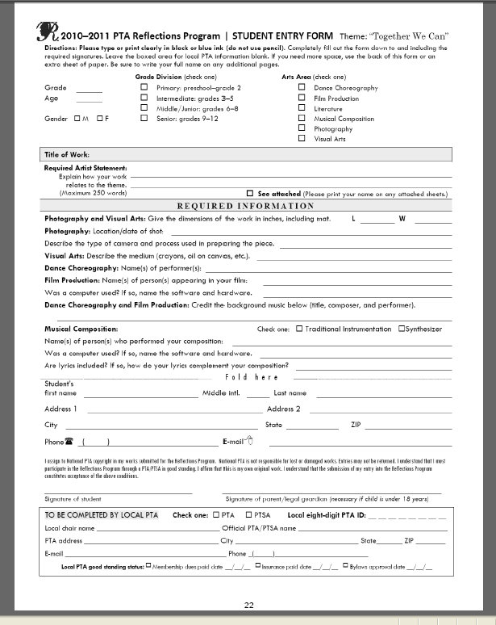
Student Entry Form
Note: Parent/Guardian must sign if student is under 18

Slide 15
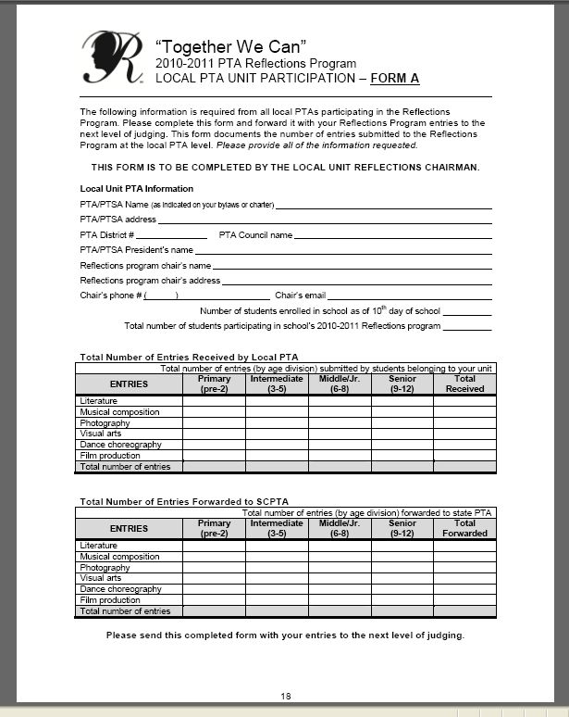
Form A

Slide 16
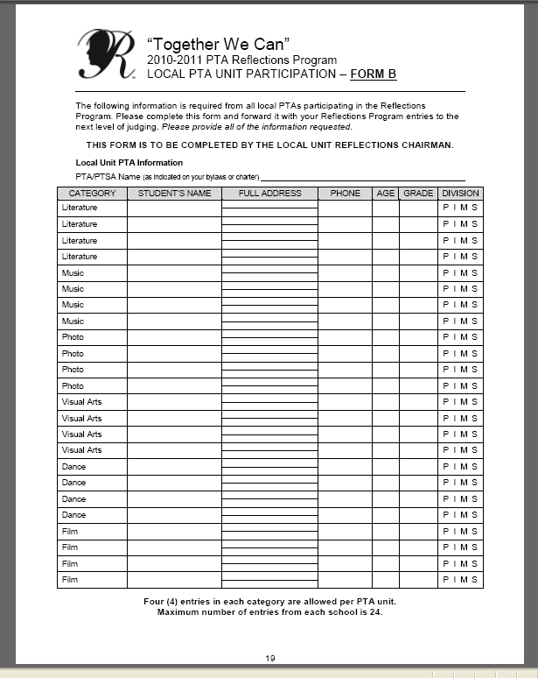
Form B

Slide 17
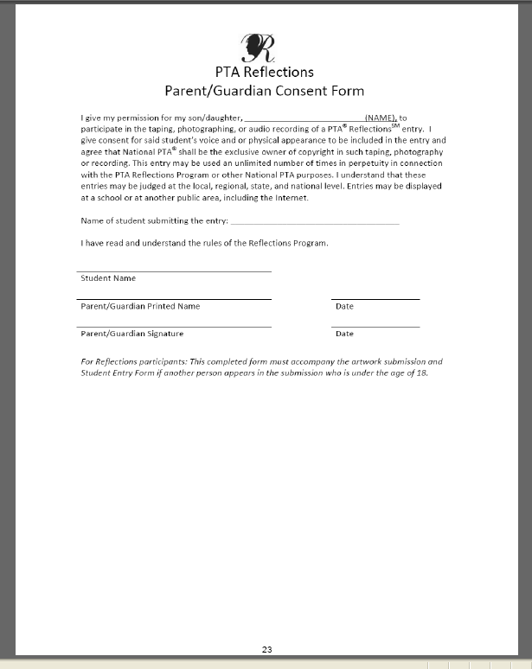
Parent/Guardian Consent Form

Slide 18
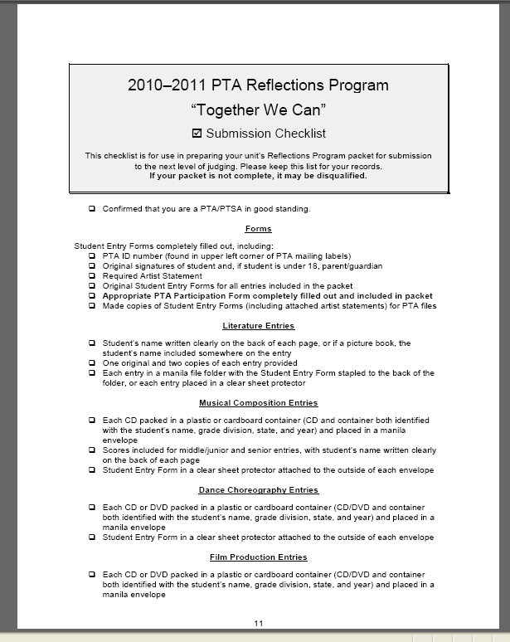
Submission Checklist

Slide 19
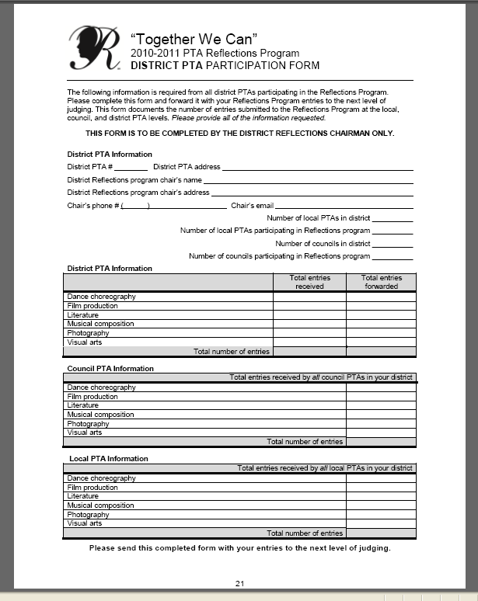
District Participation Form

Slide 20
Questions??

Slide 21
www.ptareflections.org
For more information about the Reflections Program, please visit,

Slide 22
Resources available at PTAreflections.org include:
PTA Reflections Program State Arts Chairs’ Guide, and Local Arts Chairs’ Guide
National award information
General participation and arts area rules
Student entry form and parental consent form
Local FAQs
Guidelines on using the PTA Reflections logo
Promotional fliers
A gallery of national award–winning
artwork
Reflections theme search information
National
State
Local

Slide 23
Contact Information
Kima Garten-Schmidt
Carol Beard
SCPTA Reflections Chair
reflections@scpta.org
Adapted from workshop 304 presented at 2010 National PTA Convention.

