Slide 1

SOUTH CAROLINA
End of the Year Duties for Treasurers
Candace Leggett, SCPTA Treasurer
2013 SCPTA Convention
Saturday, May 4, 2013

Slide 2

Let’s Talk About
Money Management
Reports and IRS Regulations
Insurance Needs
Fund Raising
Resources
Best Practices
SOUTH CAROLINA

Slide 3
First Steps!
Make sure a financial review/audit is done
Check the files!
Study duties and reference to finances/budget in your PTA bylaws
Secure signatures of authorized officers
File signature cards with bank
Check on bond and liability insurance
Review PTA Money Matters
SOUTH CAROLINA

Slide 4
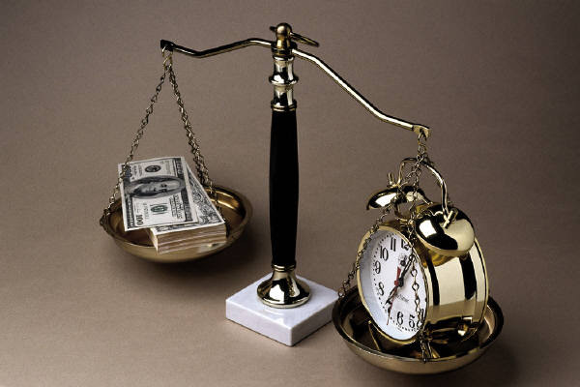
Money Management
SOUTH CAROLINA

Slide 5
Money Management
Develop a realistic budget
Review Records Retention Schedule
Store records properly — keep:
      Copies of all Treasurer’s Reports
      Bank Statements and Reconciliations
      Check Request or vouchers
      Deposit Receipts
SOUTH CAROLINA

Slide 6
Reporting
Make a report at all Board meetings
Develop a report that best reflects a transparent process
  Budget Amount
  Monthly Report
  Year-to-Date Total
  Balance of Line Item
SOUTH CAROLINA

Slide 7
Reports And Regulations
Follow all State and Federal
guidelines
Follow your approved budget,
amend if needed
Perform a financial review/audit
at year’s end, or when needed
Review relevant areas of www.irs.gov
SOUTH CAROLINA

Slide 8
Form 990 Overview
990 is a tool for an Exempt Organization to show:
  It is organized and operated as a tax-exempt entity
  It is in compliance with all applicable tax laws
  It has a mission it continues to fulfill
  It responsibly safeguards its assets

Slide 9
A Correct And Timely Form 990
Who should file?
Which form should be filed?
When to file?
Why is this important?
What happens if we don’t file?

Slide 10
Which Form 990?
Small Organizations - Form 990-N
Medium-size Organizations - Form 990-EZ
Large organizations - Form 990

Slide 11
2010 - Which Form?
Tax Year 2010
All organizations may file | 990
Gross receipts below $200k Total Assets below $500k | 990-EZ
Gross Receipts at or below $50k | 990-N

Slide 12
How to get to 990-N
To complete 990-N, you will need:
  Employer identification number (EIN)
  Tax Year
  Legal name and address
  Other names the organization uses
  Name + address of a principal officer
  Web site address (if one exists)
  Confirmation that gross receipts are normally at or below the threshold
  Termination statement (if applicable)

Slide 13
When To File?
Forms 990, 990-EZ, 990-N and 990-PF Due:
  15th day of the 5th month after the organization’s accounting period ends
  Request extension with Form 8868 on or before the due date

Slide 14

Financial Review/Audit

Slide 15
Purpose Of The PTA Audit
To certify accuracy of books and records
To assure membership resources are being managed properly

Slide 16
Three Types Of Financials
Compiled Financial Statements
  Limited or no verification of information
Reviewed Financial Statements
  Perform some inquiry and analytical procedures
  – Limited assurance of information
Audited Financial Statements
  Highest level of assurance of information
  Extensive substantiation and verification

Slide 17
Preparation For Financial Review
Financial records should be in order
Bills cannot be paid after books are closed for financial review
Materials needed include
  Copy of last financial review/audit
  Checkbook and canceled checks
  Bank statements and deposit receipts
  Itemized statements and receipts of bills paid
  Check requests or vouchers

Slide 18
Useful Resources
www.scpta.org
www.pta.org
National PTA e-Newsletters
PTA Money Matters
PTA Convention Handouts
PTA President’s Quick Reference Guide
NPTA e-learning courses
  Ethical Leadership
  Preventing Theft In Your PTA

Slide 19
IRS Resources
StayExempt.irs.gov
Mini-Courses on IRS.gov
EO Update
Specialized Assistance on Tax-Exempt Organizations and IRS Tax Forms can be found at the Exempt Organizations (EO) website:
    www.irs.gov/eo
    (toll-free) 877-829-5500
    Customer Account Services
    Internal Revenue Service
    TE/GE Customer Account Services
    P.O. Box 2508, Cincinnati, OH 45201

Slide 20
Candace Leggett, SCPTA Treasurer
treasurer@scpta.org
SOUTH CAROLINA

