Slide 1
Grassroots Advocacy
Who, me???
Created by
Katy Pugh Smith Lee Yarborough
katypughsmith@bellsouth.net lee@propelhr.com
Notes:
Joy
Legislative advocacy simply means speaking up on behalf of our children.
It is one of the most important things you can do for your child.
The laws being passed today will affect not only our children, but future generations.
Once these laws are on the books, they stay on the books.
The key to making a change is to find out about pending bills before you read about
them in the newspaper.
So what can we do?
Using simple tools, we will show you how to harness your power to protect our children.
There are 73,000 potential voters in the SCPTA.
We are the silent majority on education issues.
We don't organize politically because we think it is too hard, too awkward, too time-consuming, or it won't make a difference anyway.
But organized advocacy can be effective and fun!
During this simple video, we will show you:
How to use a PTA legislative advocacy training demonstration in your schools.
How to sign up for Public Education Partners' News-Action email alerts to keep parents informed and explain exactly what they need to do to speak up.
How to create your own communication network to leave a legacy for incoming parents after your child moves on.
(4) How our schools are funded, how funding has changed, and why now is the time to learn how to speak out on your child's behalf.
The role of the PTA is changing. We can ALL play a vital role in the education of our children if we take a few moments to get informed, speak out, and ask other parents to join us in protecting the future of our children.
Advocacy is a team effort!

Slide 2
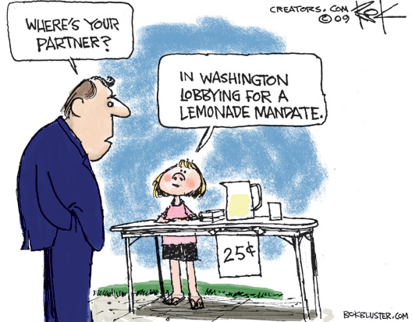
Advocate? Who, me?
This image is copyright protected. The copyright owner reserves all rights.
Notes:
Katy –
Many parents and volunteers are uncomfortable with advocacy
But there are many issues that are critical to our families, our childrens’ future, and to us as taxpayers and residents on which our elected officials need to hear our opinions
We as citizens are exactly what is right about our political process!

Slide 3
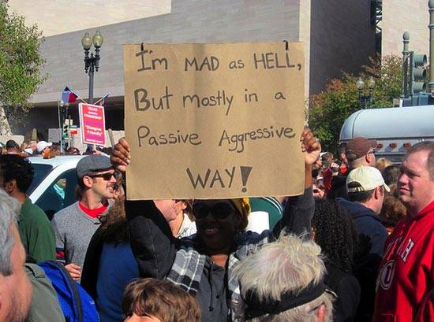
“I feel awkward asking for something.”
Notes:
Katy –
Why do we feel “funny” about advocacy?
Seems rude to ask for favors
Feel impolite talking about politics with others – we don’t know where other parents stand on issues, so we don’t want to offend them
We feel we don’t fit the activist mold – want to keep our opinions to ourselves
But…..
Our elected officials WANT to hear from us.
They are in office to represent us. If they don’t know what we want, they won’t know how to represent our opinions.
In meetings, officials will frequently say, “The people in my district believe…..” How will they know if they don’t hear from us?

Slide 4
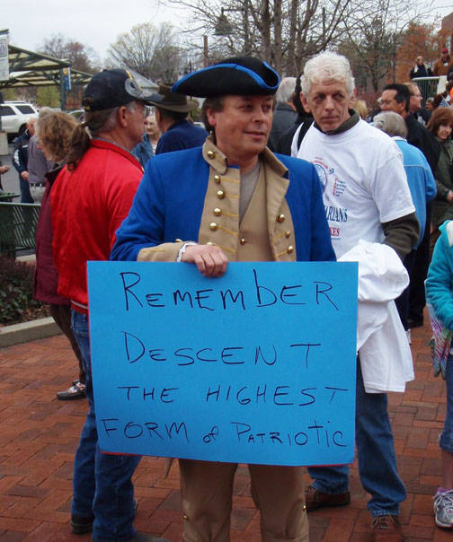
“I don’t know enough about the issues.”
Notes:
Katy - Unfortunately, many people in our nation don’t know much about the issues.
But that doesn’t stop them from getting out and advocating.
So don’t worry that you don’t have a Masters in public policy. Seriously – there are many people who don’t know much or who are guided by misinformation who are calling their elected officials and LOUDLY.
I have been in a county council meeting before on an issue that seemed completely logical – a no-brainer to pass – but a small but vocal group of people barraged their council members with calls the day of the meeting, and it was voted down. This is heartbreaking. You can’t assume that because you don’t know enough or because the issue seems clear that your call isn’t important.

Slide 5
NEWS-ACTION Be Informed. Take Action. Improve Greenville’s Public Schools.
Welcome to Public Education Partners' NEWS-ACTION—a brief, periodic update on issues affecting Greenville County public schools and actions you can take to help improve our schools.
Today's Topic: | Votes tomorrow on tuition tax credit/school voucher bill
State House and Senate subcommittees are expected to vote on tuition tax credit/school voucher bills on Wednesday. Two identical pieces of legislation, Senate bill S.414 and House bill H.3407, would provide tuition tax credits and school vouchers for families sending their children to private schools. Both bills are called the "South Carolina Educational Opportunity Act." Tomorrow, a debate and vote on the Senate bill will occur in the Senate Education K-12 subcommittee and likewise the House bill in the House Ways and Means General Government subcommittee. Both bills would provide the following: 1) A tuition tax credit for families sending their children to private schools. After three years, the tax credit would be available to all families regardless of income; 2) A tax credit of $1,000 per child for families that homeschool their children; and 3) A tax credit for individuals and corporations that donate money to an organization that in turn uses the money to give a school voucher (a "scholarship') for children in low-income households to attend a private school. The amount of the tuition tax credit and the school voucher are both tied to a certain level of state K-12 funding. For the current year both would be worth $2,720. Donations by individuals and corporations to a "student scholarship organization" and the value of their tax credits are unlimited. Read more.
Public Education Partners opposes tuition tax credit and school voucher legislation. Public Education Partners' opposition is based on the following: - Lack of accountability to taxpayers. Public schools are academically and financially accountable to taxpayers. Under the proposed bills, private schools benefiting from tuition tax credits and school vouchers in this government program would lack similar accountability and transparency. - Private schools choose who to admit. Many, if not most, private schools will not be options for children performing below grade level or with behavioral problems. Lack of transportation and an inability to pay for tuition up front and cover the rest of the cost of tuition is a barrier for students in low-income households. - Families with students already in private schools are the primary beneficiaries. - A tuition tax credit and the school voucher program would cost the state millions of dollars. State revenue would be reduced leaving fewer resources for public schools and other state needs. The tax credit/voucher bill introduced in the last legislative session would result in an estimated net revenue reduction of $128 million in the first year of full implementation. - No gain in student achievement. Despite twenty years of school voucher programs in different areas of the country and over a decade of tuition tax credit programs in some states, it has not been established that tuition tax credits and school vouchers improve student achievement. Read more.
SCPTA
National PTA
SC School Boards Association
SC Association of School Administrators
Local advocacy organizations
Public Education Partners in Greenville or Aiken County
Your school district
Notes:
Lee –
The good news is there are ways to get informed.
If you’re interested in public education, several good organizations have researched the issues for you.
Hopefully, you’re signed up for Public Education Partners “News-Action” alerts, which will briefly tell you about the issue and whom to call.
These are a few other good resources….
And hopefully we can get our SICs and PTAs organized to let you know what you need to know and when….
But additional good news is that when you get involved in advocacy, there will be no quiz on your knowledge. Which leads me to my next point…

Slide 6
“They’re too busy to listen to me.”
Vote Yes! Yes Yes Yes Yes
Yes Yes Yes YesYes Yes
Yes Yes Yes Yes Yes Yes Yes
Yes Yes Yes Yes Yes Yes
Yes Yes Yes Yes Yes Yes Yes
Yes Yes Yes Yes Yes Yes Yes
Yes Yes Yes Yes Yes Yes Yes
Yes Yes Yes Yes Yes Yes Yes
No No
No
No No No
No
Notes:
YOU as a constituent are the business of an elected official. He or she may disagree with you but will always listen to you.
But here’s the thing – when you call, it is extremely unlikely that your senator or representative will be the person picking up the phone. Instead it will be a secretary who also serves at least one other house or senate member. And all she really wants to do is take your message about why you’re calling.
If it’s a hot issue, she’ll be recording calls just like yours all day.
What you don’t want to happen, though, is to have your cause on the other side of the tally sheet. If all day, she’s recording calls from your opposition, you will make little impression on your busy Representative when the secretary says, “200 people called supporting the bill and 7 people called opposed.” He’ll know exactly what his constituents think.
This is why all of our calls are so important.

Slide 7
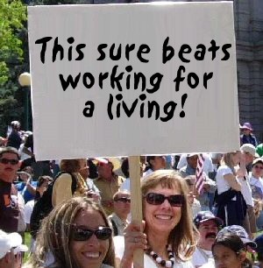
“I don’t have enough time to do this.”
Notes:
If you haven’t been involved in advocacy before, you may feel it is something best left to former hippies, passionate grad students without real jobs and commitments, or retirees.
But your role can be very small but very critical.
The truth is most public school parents have full time jobs, either paid in a workplace or at home as a parent. That is why it’s so important to make it easy for your PTA volunteers. Reach out to parents who might not otherwise have time for volunteer work but who would be willing to make a quick phone call.

Slide 8
Short and sweet advocacy
Use a script
“Hi, this is ___. I wanted to let Sen. ?? to know I am opposed to bill ###.”
Be concise and polite
You don’t need to know the answers, but find them out
You can ask, “Do you know how Sen. ??? is planning to vote?”
Follow up with a note
Notes:
To really have an impact, those of us interested in public education need key people who can be knowledgeable and commit a lot of time to these issues AS WELL AS many people who can take about 15 minutes as issues come up – which will be every few weeks during the legislative session – to make phone calls.
If you haven’t done this before, here are tips to make it easier:
Use a script – write on a sheet of paper what you’d like to say and who you want to call. Check them off as you go.
Be concise and polite. The person who answers the phone really just wants your name and whether you’re for or against. Don’t give them a bad taste in the mouth about you and your cause.
You don’t need the answers – if by some surprise chance you do reach the Sen. Or Rep and he or she asks you more, tell him how you feel and what you do know. If you don’t know, say, “I’ll find out” and do some more research, then get back to him.
You don’t have to do this, but it is OK to say, “Do you know how he’s planning to vote?”
Once the vote has taken place, it’s nice to follow up with an email or handwritten note to thank him if he voted supporting your position.

Slide 9
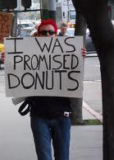
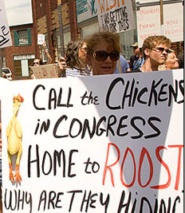
What is a win?
An elected official:
Pushes your issue
Votes your way
Doesn’t push against your issue
Does nothing

Slide 10
Sample Advocacy Program
Occasionally….
Gather and share information
Ask people to call or write
Call or write when asked
Take a public stand
1 person,
regularly during school year
1-5 people,
a half hour a few times a year
10 – 20 people,
a few minutes a few times a year
Notes:
We have a process in our own schools that we’d like to share with you. In fact, today we’re inviting you to join us as schools that view advocacy as central to their mission. Because if an issue comes up that is important to education and there are 70,000 students in Greenville County Schools, it doesn’t say much if just a few dozen parents call. We need to let our elected officials know we care, and that means all of our county’s PTAs and SICs need to get involved.
Most people are involved in this process at this bottom level. Our PTA executive board and our SIC have received advocacy training, and when issues come up we enlist their help in making calls. This has been only twice this school year and has taken up only about 10 minutes of each person’s time. But we know that when we sound the bell, we can get about 20 phone calls to an elected official.
At the next level are our PTA presidents and SIC co-chairs as well as our PTA legislative affairs chair. We all subscribe to several e-alerts on advocacy issues and touch base with each other about how best to keep our parents informed and when to sound the advocacy bell. We make sure we put our advocacy resources at the school to the best use.
But it helps to have one point person whose main job it is to focus on advocacy. That way you can really map out a full strategy for the school, including newsletter articles, training for parents, and tours for elected officials.
Finally, every once in a while, your school might really want to take a stand. This might not even be every school year. But it could be a petition you circulate, a letter to the editor, or a carpool visit to the capitol.

Slide 11
Starting a PTA/SIC Advocacy Program at your school
Identify a point person
Who will follow the issues? Who will lead your program?
Identify 15 or more advocates willing to make calls
Conduct an advocacy training at your school
Set up communication methods
Phone/email trees and follow up
Notes:
So, to restate it, we’d like to enlist your school to join us in formalizing your advocacy efforts.
First, identify a point person.
Second, identify 15 or more advocates who are willing to make calls. This can’t just be a statement from you that your Exec Board would probably do it. You need this to be people who are signing on to make these calls and call you back to confirm that they’ve done it (provided they are in agreement on the issue). It can be your spouse, both of your parents, and your aunt! We just needed numbers on our side.
Third, conduct an advocacy training at your school. This could be your point person having a simple discussion with your recruits and other school volunteers or better yet a training by Craig Stine.
Finally, set up communication methods….

Slide 12
Other advocacy activities…
Letter writing campaigns
Open house or personal tour of your school
Visit with elected official in Columbia
Raise parents’ awareness
Communicate with parents through newsletter, Facebook, etc.
Inform parents during general PTA meetings
Staff person from Sen. Graham’s office and
SC Rep. Eric Bedingfield at Blythe Report to Community

Slide 13
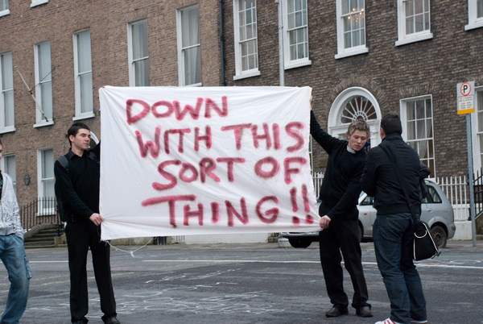
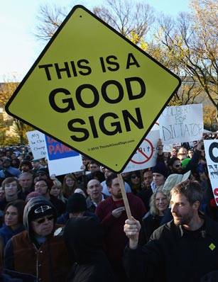
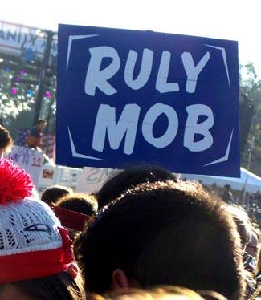
Get Involved!
Notes:
Recognize…..
Some schools already have this underway – any experiences they wish to share???
Some people present may not be PTA leadership…… how can we help them enlist their school?
Some people may still be uncertain….that’s OK. How can we help???
Distribute materials….

Slide 14
Legislative Advocacy Training Video

Slide 15
Resources
SCPTA @ www.scpta.org
National PTA @ www.pta.org
SC School Boards Association @ http://www.scsba.org/advocacy_grassroots.htm
SC Association of School Administrators @ www.scasa.org
Public Education Partners of Greenville County @ www.pepgc.org
Public Education Partners in Aiken County @ http://publicedpartners.org/
www.joy4education.com

