Slide 1
PTA Reflections® 101
Follow along in your Local Leader’s Guide
available for download at scpta.org
Presented by Carol Beard
South Carolina PTA Reflections Chair
Summer 2013
Notes:
Thank you for joining us today! My name is Carol Beard from SCPTA (I live in Simpsonville) and this training is for Local PTA Reflections Chairs and other Local PTA Leaders interested in providing students with opportunities to explore and be involved in the arts.
You may reference your Local Leader’s guide to Reflections during this presentation and/or take notes to remember ideas that interest you.
If you are following along in your guide, the chapter and section numbers are available for your reference and located at the bottom-left side of your screen.
If you did not receive a Local Leader’s Guide, please visit scpta.org to download your own copy after this session.

Slide 2
PTA’s Mission
The overall purpose of PTA is to make every child’s potential a reality by engaging and empowering families and communities to advocate for all children.
PTA Values
Collaboration: We work in partnership with a wide array of individuals and organizations to accomplish our agreed-upon goals.
Commitment: We are dedicated to promoting children’s health, well-being, and educational success through strong parent, family, and community involvement.
Accountability: We acknowledge our obligations. We deliver on our promises.
Respect: We value our colleagues and ourselves. We expect the same high quality of effort and thought from ourselves as we do from others.
Inclusivity: We invite the stranger and welcome the newcomer. We value and seek input from as wide a spectrum of viewpoints and experiences as possible.
Integrity: We act consistently with our beliefs. When we err, we acknowledge the mistake and seek to make amends.
1.0

Slide 3
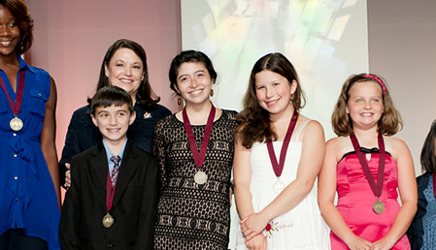
All children deserve opportunities to
explore and be involved in the arts.
Notes:
The National PTA believes that “All children deserve opportunities to explore and be involved in the arts” and the PTA Reflections program provides just that!
All children include those with disability and special needs,
[END]

Slide 4
Participation in the arts…
Levels the playing field for underserved students.
Develops the whole-child.
Nurtures creativity and teamwork.
Connects family, schools, and communities.
2.0
Notes:
[SAY]
We know the value of participating in the arts.
Participation in the arts can level the playing field for underserved students. Studies find that students from low socioeconomic backgrounds, English language learners, and students with special needs—often underserved in public schools—show the greatest relative improvement in academic achievement when participating in arts programs such as Reflections.
Participation in the arts develops the whole child. Through movement, social interactions, emotional expression and application of skill, arts education provides an academic advantage to students. The arts provide safe learning environments where students take risks, explore ideas, express their individuality and support their peers in a positive way. Studies also find that students are more engaged and teachers are more effective in arts-rich schools.
Participation in the arts connects families and schools to one another and to their communities. Research shows a significant relationship between arts education, family engagement and community participation. Students with involved parents are more likely to earn higher grades and test scores, pass their classes, attend school regularly, have better social skills, graduate and go on to postsecondary education. Students who study the arts develop a sense of personal responsibility toward their communities and have the ability to positively affect the community social life through artwork.
I might be inclined to leave this sentence out, here. It’s said below, and these bullets are getting pretty long. What do you think?
[END]

Slide 5
Today you will learn about…
1. PTA Reflections®
2. Program Planning
3. Organizing Your Team
4. Promoting Reflections
5. Collecting and Judging Student Entries
6. The Next Level - State and National Recognition
7. Celebrate! Recognize Student Participation and Achievement
8. Wrapping Up
Appendix Items
Notes:
[SAY]
Today you will learn about…
The PTA Reflections program.
How to plan your Reflections program.
How to organize a Reflections Committee or team of volunteers.
How to promote your program in your school or community.
How to collect student artwork and judge student entries.
Opportunities for students to receive State and National recognition.
Celebrate and recognize participating students for their achievement in the arts.
Wrapping up your program as it comes to a close.
[END]

Slide 6
About PTA Reflections®
Reflect!
Explore!
Celebrate!
Since 1969, the Reflections program has allowed millions of students
to explore their artistic talents in an educational way.
“The cultural arts are happiness. Happiness is drawing, dancing, finger painting. Happiness is modeling with clay, making music or a poem, performing a play.”
-Mary Lou Anderson, founder of National PTA’s Reflections Program
2.1
Notes:
[SAY]
Since 1969, the Reflections program has allowed millions of students to explore their artistic talents in an educational way.
PTA Reflections is not a replacement for existing arts education programs. Reflections is a program that can be added to existing arts programs in your school and community by providing new opportunities for recognizing student participation and achievement in the arts.
Reflections also may serve as an opportunity to connect with community arts organizations that can enhance student learning and bring families together.
Mary Lou Anderson, Founder of National PTA’s Reflections Program states: “The cultural arts are happiness. Happiness is drawing, dancing, finger painting. Happiness is modeling with clay, making music or a poem, performing a place.”
Think of the entire Reflections program in just 3 simple steps:
Thousands of students from across the country and in American schools overseas will reflect on a common theme.
These students will explore one or more arts disciplines including: Dance Choreography, Film Production, Literature, Music, Photography, and Visual Arts.
All students are recognized for their participation and achievement in the arts.
[END]

Slide 7
Who can participate?
All Local PTA Units in GOOD STANDING may host a Reflections program.
Good Standing:
All Dues paid
Current Bylaws
Bonding Insurance policy in place
IRS Form 990/990N complete for previous fiscal year
Financial Review Report & Checklist complete & on file with State office
See Appendix A for list of South Carolina Reflections dates
2.1 Appendix A

Slide 8
2013-14 Theme:
Believe, Dream, Inspire
“My inspiration for the theme came from my experience
in competitive sports.
I hope that students across the country will strive to
make their dreams become a reality.”
-Julie Lampert,
Waverly Park PTA, NY
Notes:
Each fall, thousands of students submit concepts for a future Reflections theme to their state PTA.
State PTAs will select five themes to submit to National PTA for consideration.
Student with the winning concept receives a cash prize and public recognition.

Slide 9
PTA Reflections and the National Standards for Family-School Partnerships
Welcoming all families
Communicating effectively
Supporting student success
Speaking up for every child
Sharing power
Collaborating in the community
2.2

Slide 10
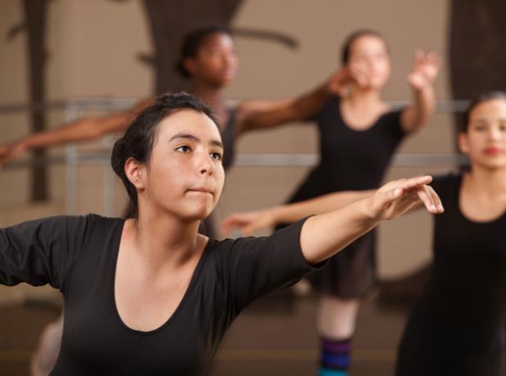
Additional Opportunities
Mary Lou Anderson Reflections Arts Enhancement Grants
Applications Available January 6, 2014 at PTA.org/Reflections
Applications Due March 14, 2014
Reflections Theme Search Contest
The next theme could come from your PTA!
See Appendix B for a student entry form and list of past themes.
Due date December 2, 2014
2.3 Appendix B
Notes:
Three, $1000 Grants are annually awarded for Arts Education projects
Schools with large at-risk student populations are encouraged to apply
Application period is January 15 – March 15, annually
Grantees are invited to share their inspiring stories on our website
Each year, the Reflections Theme is chosen from a pool of thousands of Theme ideas
One lucky student will earn $100 and have his or her idea announced at our Annual Convention
To find the Theme Search application, please visit www.pta.org/reflections

Slide 11
Chapter 3
Program Planning

Slide 12
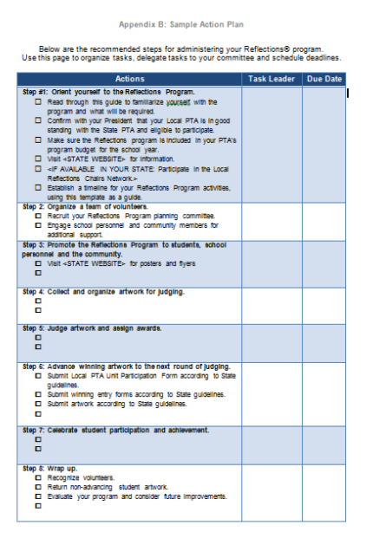
Customize Your Action Plan
Use this tool to:
Brainstorm tasks
Assign roles and responsibilities
Track due dates
3.0 Appendix C
Notes:
Step 1: Orient yourself to the Reflections Program
Step 2: Organize your team
Step 3: Promote the Reflections Program
Step 4: Collect and organize artwork for judging
Step 5: Begin judging process
Step 6: Advance winning artwork
Step 7: Celebrate student participation and achievement
Step 8: Wrap up

Slide 13
We’re Here to Help You!
Webinar: Reflections 101
Dates: Join us live on the second Tuesday of the month from 8:30 P.M. to 9:30 P.M. ET
August 13, 2013 https://www3.gotomeeting.com/register/140920390
September 10, 2013 https://www3.gotomeeting.com/register/494872822
October 8, 2013 https://www3.gotomeeting.com/register/832222294
Webinar: National PTA Reflections Online Registration System
Dates: Join us live on the third Tuesday of the month from 8:30 P.M. to 9:30 P.M. ET
August 20, 2013 https://www3.gotomeeting.com/register/500005510
September 17, 2013 https://www3.gotomeeting.com/register/924000326
October 15, 2013 https://www3.gotomeeting.com/register/238460638
November 19, 2013 https://www3.gotomeeting.com/register/899255502
December 17, 2013 https://www3.gotomeeting.com/register/689518126
See Appendix D for a complete schedule of state and national
networking and training opportunities
3.0 Appendix D

Slide 14
Chapter 4
Organizing Your Team

Slide 15
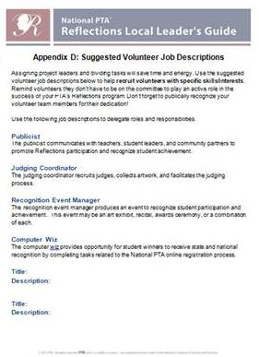
Roles and Responsibilities
Create a committee
Establish a timeline
Communicate with other PTA leaders
Represent your Local PTA at statewide arts-related events
See Appendix E for Suggested Job Descriptions.
4.1 Appendix E
Notes:
Publicist- Works for teachers, student leaders, and community partners to promote Reflections.
Computer Wiz- Keeps track of student participation information and completes tasks related to the online registration process.
Judging Coordinator- Recruits judges, collects artwork, and hosts judging event.
Awards Specialist – Coordinates with community/school leaders to present art exhibit/awards ceremony/etc.

Slide 16
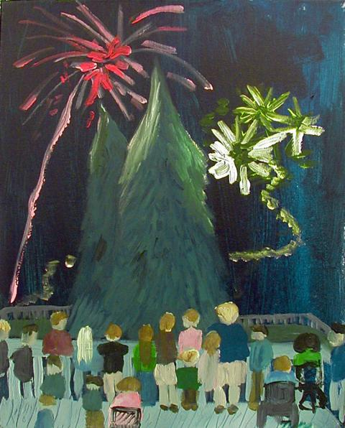
Tips for Recruiting Reflections Volunteers
Announce planning meetings, ask school leaders to make recommendations, extend personal invitations
Utilize your student leaders
Consider school staff
Assign specific tasks to volunteers without requiring their attendance at planning meetings
Cultivate community arts professionals
Nicholas Turgeon, 1st place Visual Arts, Intermediate, 2012-13
Stone Academy, Greenville
4.2

Slide 17
Recruiting Volunteer Judges
Increase the credibility & expand the visibility of your program!
Sources may include working arts professionals or arts students in
local arts organizations, companies and colleges.
Examples:
Newspaper Editors/Arts Reviewers & Local TV News Producers
College/university Professors, Graduate Fellows, Undergraduate Students
4.3

Slide 18
Chapter 5
Promoting Reflections

Slide 19
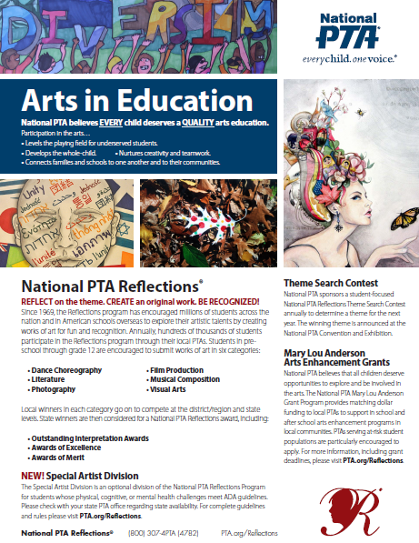
Program Messages
All children deserve opportunities to explore and be involved in the arts.
Students have the opportunity to explore the arts and culture, develop creative thinking and problem-solving skills and recognize themselves as artists.
The 2013-14 Reflections theme is Believe, Dream, Inspire…
Families can support their children’s participation.
All students are welcome to interpret the theme and explore the arts including students with special needs.
5.1

Slide 20
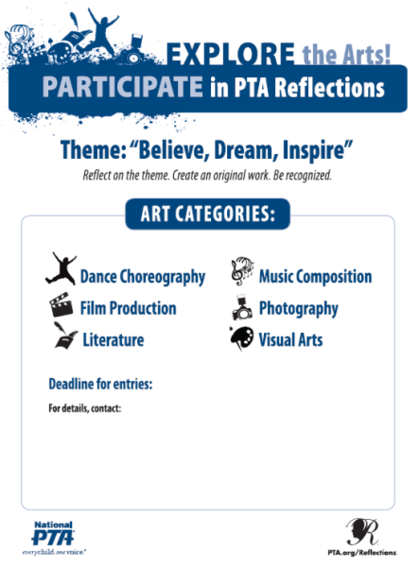
Student Recruitment Messages
Create your own messages targeting:
School newspaper
Morning announcements
Activity fairs promoting school clubs
Customize a participation flyer
Enter your deadline for entries, how to submit entries and contact information
Print flyers or enlarge for posters
Recruit students to hang posters in hallways
Ask teachers to send flyers home
Distribute on Back-to-School Nights
5.2 Appendix F

Slide 21
5.3 Ideas for Promoting Reflections
Students & Families
Host assembly
Teachers & Administrators
Visit staff meetings
Link Reflections to curriculum
Community
Provide morning announcements
Hang posters and flyers
Post info on websites
Post a blog/newspaper article
Use Facebook/Twitter
Appoint student leaders
Plan awards ceremony with school leaders
Serve as judges
Exhibit artwork
Donate
Provide media coverage
Post announcements on bulletin boards
5.3

Slide 22
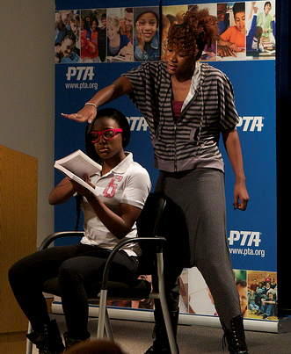
Networking With Other Local PTAs
Connecting with other Local Reflections Chairs can help build your support network.
By communicating about challenges and successes, Local Reflections Chairs can help one another with:
Identifying community judges
Promoting the Reflections Program in the community
Locating affordable vendors
Finding additional sources for support
Make sure your Chair’s contact information is on file at State Office!
office@scpta.org
800-743-3PTA
Communication will be via email and social media sites
Racquel Charles “True Colors”
U.S. Department of Education
5.3
Notes:
[APPENDIX C IS OPTIONAL]

Slide 23
Recognizing outstanding Reflections programs
The Debbie Shumpert Reflections Participation Award
SCPTA will provide one award each to the Elementary School, Middle School, High School and other participating educational institution that has the highest level of participation by students in the 2013-14 Reflections Program.
The District(s) or Council(s) with the highest total school participation rate will also be recognized.
This recognition is in honor of Debbie Shumpert, SC State Reflections Chair for six years, for her outstanding dedication and inspiration. Mrs. Shumpert fought a courageous battle with cancer and passed away in 2005.
The SCPTA State Reflections Committee will review the total number of participants in each school & divide this total by the school enrollment to determine the highest ratio of students to participants. Winners will be announced at the State Convention.
5.4
Notes:
OPTIONAL

Slide 24
Chapter 6
Collecting and Judging
Student Entries

Slide 25
Deadline for Entries
Will need at least two weeks for judging
Allow two weeks to prepare entries for the next round of judging.
Please check with your District level PTA to determine if any additional rounds of judging take place in your area.
The State turn-in date is Saturday, February 8, 2014 at the Richland County
Downtown library: 1431 Assembly Street
Columbia, SC 29201
6.0

Slide 26
Understanding Program Rules
PTA Units often participate in one or more arts categories
Students often participate in any or all arts categories
General Participation Rules
Arts Category Rules
Student Eligibility and Entry Guidelines
Dance Choreography
Music Composition
Film Production
Photography
Literature
Visual Arts
6.1 Appendix G

Slide 27
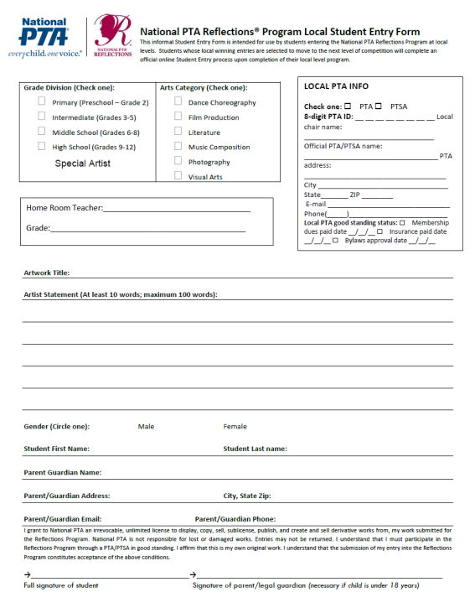
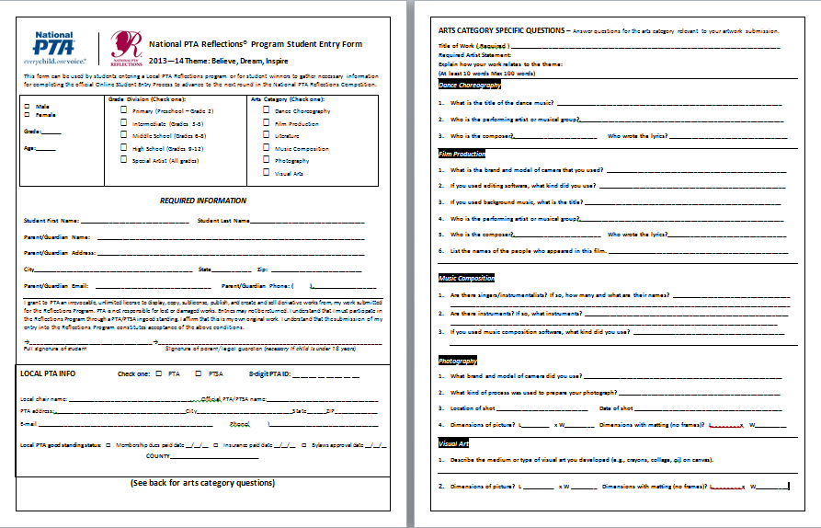
Sample Student Entry Form
6.1 Appendix H
Notes:
In the Local PTA INFO BOX: Use their own state’s Unit in Good Standing guidelines to answer this question

Slide 28
Summary of Rules
Students must be affiliated with a PTA/PTSA in good standing, as determined by State PTA
Students may submit entries in more than one arts category
Artwork must be original and created for the purpose of this contest and this year’s theme
Only one student may create the work and be recognized as the award recipient, but other students may appear in the artwork itself

Slide 29
Rules Continued
Use of copyrighted material is prohibited except:
Music in dance choreography and film production when the title, composer and performer are cited in the submission
Your State PTA will provide rules and Local PTA Reflections Guide
General participation, specific arts category and Special Artist Division rules must be followed at all levels

Slide 30
Special Artist Division
Primary
Grades Pre-K-2
Middle School
Grades 6-8
High School
Grades 9-12
Intermediate
Grades 3-5
Special Artist
All Grades
6.1

Slide 31
Originality & Copyright
Originality
Adults may not alter the creative integrity of a student’s work
Only one student may create the work and be recognized as the award recipient, but other students may appear in the artwork itself
Artwork must be inspired by the theme: Believe, Dream, Inspire…
Copyright
Use of copyrighted material is prohibited in the literature, music composition, photography and visual arts categories.
Use of copyrighted material is acceptable in the dance and film production arts categories when the title, composer and performer of any music in the submission are cited on the student entry form.
Reference your Local Leader’s Guide for more information
6.1

Slide 32
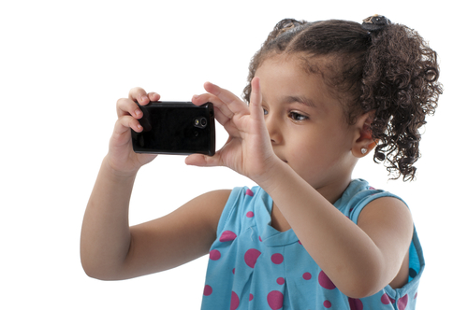
Addressing Student Ineligibility
Common reasons for ineligibility include:
Local PTA is not in good standing with the State PTA
Plagiarism
Resubmission
Recommended procedure:
Scan entries
Alert judges
Check questionable entries
Return ineligible pieces
Talk with appropriate school personnel
Determine whether awards should be returned
6.1

Slide 33
Collecting Entries
Consent Forms
Optional
For individuals other than the student submitting artwork
For individuals appearing in or performing on film, dance, or photography entries
Appendix I
Catalog entries
Keep track of numbers of entries and number of student participants
Keep entry forms with artwork
Keep records of participants to identify potential Reflections volunteers in supportive families and teachers
6.2 Appendix I
6.

Slide 34
Judging Process
Entries primarily judged on the interpretation of the theme
Conduct blind judging
Provide judging rubric and score card to your judges (See Appendix J below)
Assign awards
NOTE: If two entries are tied, the entry with the higher score for interpretation of the theme receives more recognition.
6.3 Appendix J

Slide 35
Sample Judging Rubric
Interpretation of Theme | How closely the artwork communicates the theme, based on the artwork itself and the artist statement | 20 pts
Artistic Merit/ Creativity | How creative and original the artwork is in its conception of the theme and its presentation | 10 pts
Mastery of Medium | The level of skill demonstrated in the basic principles/techniques of the artistic discipline | 10 pts
6.3 Appendix J

Slide 36
Chapter 7
The Next Level - State and
National Recognition

Slide 37
Reflections Program Structure
Local PTA
Council PTA
District PTA
State PTA
National PTA
Region PTA
Only in District 1 & 9
Not in SC
Notes:
Instructions to Edit:

Slide 38
Report Participation
After your judging process is complete, share participation information with your state PTA.
Complete the Paper Local Unit participation form and send it with the printed student entry forms for each piece of art that moves to the next round.
Please also complete the online participation form and online student entry forms. Use your paper forms as a guide to enter information online before advancing your forms to the next round.
See Appendix K for instructions on using the Online Registration Process
See Appendix M for paper versions of the PTA Participation Form
Complete the PTA Participation online at PTA.org/Reflections
Sydney Langsdale “Unity In Diversity”
7.1 Appendix K & M
Notes:
After your judging process is complete, share participation information with your state PTA.
Complete the Paper Local Unit participation form and send it with the printed student entry forms for each piece of art that moves to the next round.
For states that are participating in the online system for Reflections, please also complete the online participation form and online student entry forms. Use your paper forms as a guide to enter information online before advancing your forms to the next round.

Slide 39
Advance Winning Entries to the Next Round
Local Units with Council/District Level Judging
District 1 (Greenville County)
District 9 (Charleston County)
District 23 (Dorchester County)
May participate in District level judging. [District 1 also has Council level judging]. Contact your District Chair directly for details and specific dates.
Additional levels of judging allow more student entries to advance to the state level since any local winners advancing to state in a council/district portfolio are not counted towards that local unit’s total entries advancing.
7.2
Notes:
[STATE PTA MAY CREATE APPENDIX J OR INSERT GUIDANCE IN THEIR LOCAL LEADER’S GUIDE].

Slide 40
Local Units with Council/District Level Judging continued…
Local Chairs should go online at PTA.org/Reflections to manually enter entry forms for all advancing artwork.
Chairs may invite parents/students to key-in the information themselves OR
PTA volunteers may key in data.
If your local unit CANNOT input entry forms online, advancing artwork MUST be accompanied by a form listing the entries as well as contact information for the students and the local chair. An example spreadsheet is given in Appendix L.
7.2 Appendix L

Slide 41
Local Units with Council/District Level Judging continued…
Once Council/District level judging is complete:
Each local, council and district unit in good standing may submit a portfolio to state with up to
24 entries + 6 Special Artist Entries:
four (4) in each of the six (6) arts categories PLUS
up to six (6) Special Artist entries: one (1) in each of the six arts categories
Elementary schools must combine primary and intermediate age division entries to determine the 24 entries.
ALL entries MUST be received ON or BEFORE Saturday, February 8, 2014.
7.2

Slide 42
Information for Council or District Chairs
All Council and District Chairs should register online like Local Chairs. If you do not know your unit’s PTA ID number, please contact the State PTA office or the State Reflections Chair.
Schools advancing entries to this level MUST submit participation numbers either online or with a paper form.
Councils/Districts will also complete participation forms either online or with a paper form.
Artwork advancing in your portfolio must be entered online now if it was not input by a local chair already
Once student entry forms are entered online, they should be “Advanced” to the next level online before the actual artwork is exchanged.
7.2

Slide 43
Local Units without Council/District Level Judging
Local Chairs should go online at PTA.org/Reflections to manually enter entry forms for all advancing artwork.
Chairs may invite parents/students to key-in the information themselves OR
PTA volunteers may key in data.
If your local unit CANNOT input entry forms online, advancing artwork MUST be accompanied by a form listing the entries as well as contact information for the students and the local chair. An example spreadsheet is given in Appendix L.
Each local unit in good standing may submit a portfolio to state with up to
24 entries + 6 Special Artist Entries:
four (4) in each of the six (6) arts categories PLUS
up to six (6) Special Artist entries: one (1) in each of the six arts categories
Elementary schools must combine primary and intermediate age division entries to determine the 24 entries.
ALL entries MUST be received ON or BEFORE Saturday, February 8, 2014.
7.2 Appendix L

Slide 44
South Carolina PTA State Turn-in
All entries must be packaged correctly.
See Appendix N for specific instructions
Saturday, February 8, 2014
10:00 – 11:30 am
Richland County Public Library
1431 Assembly Street
Columbia, SC 29201
If you need to ship your school/district’s entries, please use a company that offers online tracking. Entries must be received by Thursday, February 6.
Ship to:
SCPTA
1826 Henderson Street
Columbia, SC 29201
“Contents: Reflections Entries”
7.3 Appendix N

Slide 45
Chapter 8
Celebrate! Recognize Student
Participation and Achievement

Slide 46
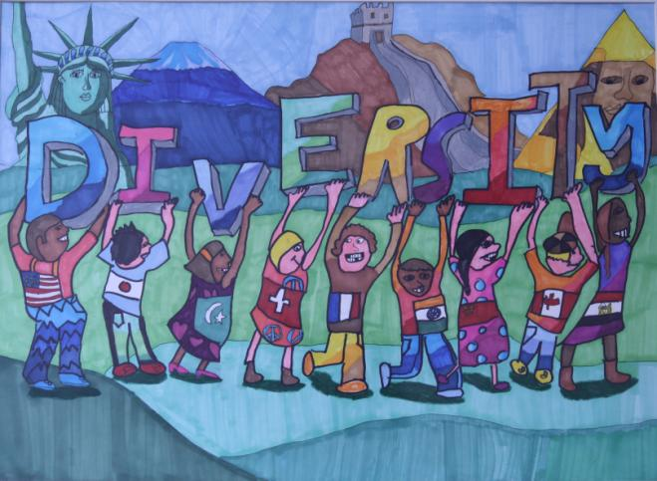
Ideas for Recognizing Students Locally
Public Announcements
School Events
Community-wide Events
PTA Meetings
School Board or City Council Meetings
Emily Lam “Diversity Means Harmony in the World”
8.1

Slide 47
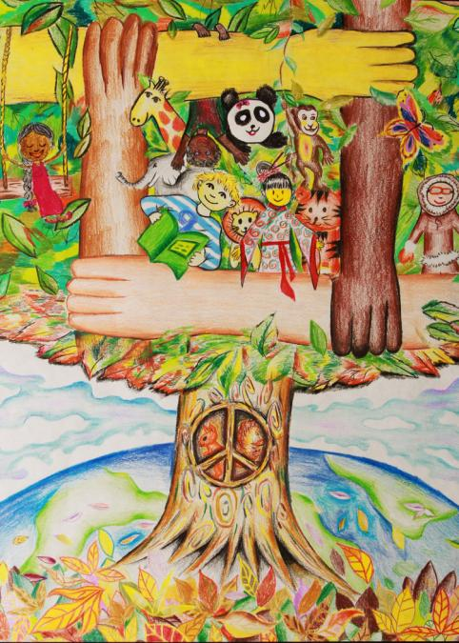
Regional and State-level Recognition
Check with council and/or district level PTA for area recognitions
SCPTA Photography and Visual Arts winners are announced the day of the state turn-in; non-winning entries are returned that day to District or Local Chairs.
Award recipients for the remaining four arts categories are announced by March 1 via email to the State Board, District Presidents, District and/or Local Reflections Chairs.
SCPTA will recognize 1st place, 2nd place, 3rd place, and two Honorable Mention winners per arts category, per grade division + Special Artist division.
Outstanding Interpretation winners may also be announced for each arts category.
All state winners will be invited via mail to the awards ceremony.
State awards ceremony will be held as part of the SCPTA Convention in Greenville in late March 2014.
First place winners advance to National PTA’s final round of judging.
National PTA awards are announced each May.
Zoe Hughes
“Diversity Means Embracing
Our Differences Peacefully”
8.2

Slide 48
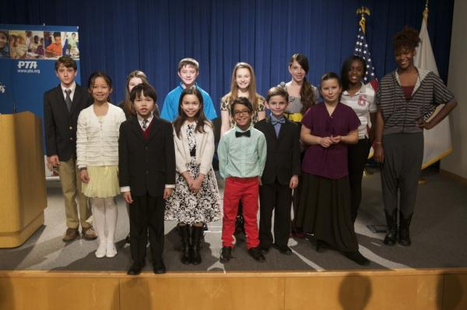
National PTA Award Levels
Outstanding Interpretation
Award of Excellence
Award of Merit
Honorable Mention
National PTA Reflections Exhibit Opening
U.S. Department of Education
8.3

Slide 49
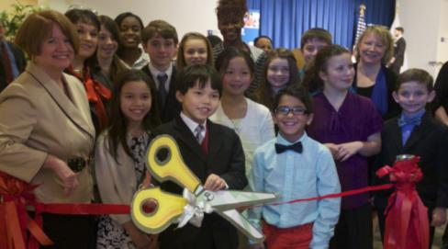
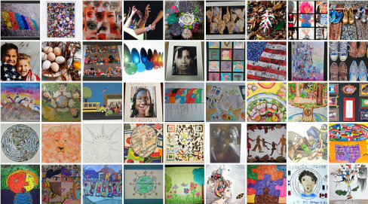
National PTA Recognition
Visit Our Annual Exhibitions
U.S. Department of Education
National PTA Convention
Visit Our Online Gallery
www.youtube.com/playlist/reflections onevoice.ptanewsroom.org
8.3

Slide 50
Chapter 9
Wrap Up & Evaluate

Slide 51
Recognize Partners and Volunteers
Don’t forget to thank those who helped make Reflections a success!
Students who entered, as well as any students who helped to promote or administer the program
PTA and community volunteers
School personnel
Judges
Community partners that provided donations, such as prizes or exhibit space
Jadyn Sano “INSERT TITLE”
Use the acknowledgment letter in Appendix O
to thank volunteers and community partners for any donations.
9.1 Appendix O

Slide 52
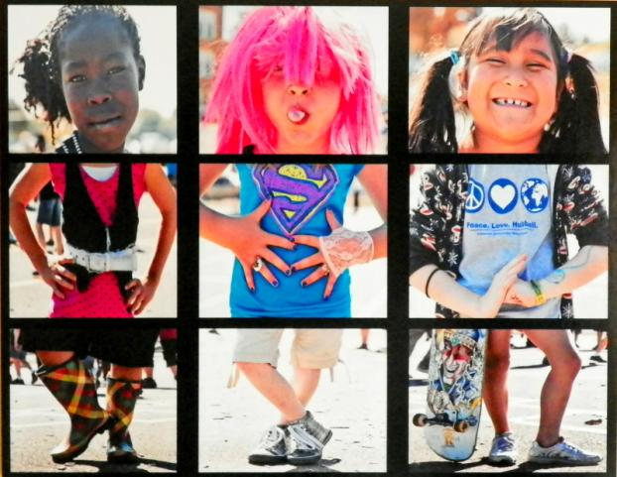
Return Student Artwork
Non-advancing original photography and visual arts pieces should be returned to student artists as soon as possible after Local PTA recognition.
Artworks submitted electronically are not returned.
Please be sensitive to secondary students needing their artwork for college admission.
Kobie Long “Scrambled Students”
9.2
Notes:
National PTA recommends that original photography and visual arts pieces be returned to student artists as soon as possible after judging and/or recognition. Art works submitted electronically, including those in the dance choreography, film production, literature and music composition categories, typically are not returned.
Non-advancing artwork can be returned immediately after judging or after your Local PTA celebration. National PTA recommends that artwork be returned by the end of the school-year. Please be sensitive to secondary students needing their artwork for college admission. If student artwork advances, it will be returned according to State and/or National policy (see below).
State PTA Policies
<DESCRIBE HOW YOUR STATE USES STUDENT ARTWORK>
<DESCRIBE WHAT ARTWORK YOUR STATE PTA RETURNS, HOW AND WHEN.>
National PTA Policies
National PTA’s award-winning entries are featured online at PTA.org/ReflectionsGallery. Visual artworks and photographs are displayed throughout the National PTA headquarters, exhibited at National PTA special events and returned within three years following their submission to National PTA.

Slide 53
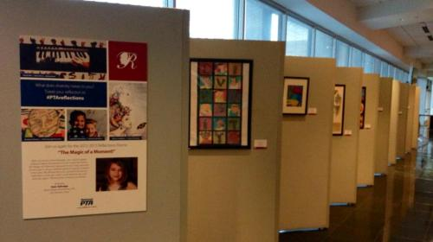
Return Student Artwork
Artwork is returned according to State and/or National policies
State PTA Policies
Winning Photography and Visual Arts artwork is displayed at the Annual Convention and Awards Ceremony.
2nd, 3rd and Honorable Mention entries will be returned following ceremony
First place winners are held until after National winners are announced.
Dance choreography, film production, literature and music composition entries are not returned.
National PTA Policies
National PTA’s award-winning entries are featured online at PTA.org/ReflectionsGallery
Visual artworks and photographs are displayed throughout the National PTA headquarters, exhibited at National PTA special events and returned within two years.
9.2

Slide 54
Evaluate Your Program
Collect feedback from your team using Appendix P: Sample Evaluation
Share with your PTA President/New Reflections Chair
9.3 Appendix P
Notes:
What worked? What didn’t?
Would you revise your timeline?
What community partners did you include?
Are there other community partners to consider next year?
What tips do you have for tracking student participation from year to year?
How will you archive important information that can be used next year?

Slide 55
Appendices
A SCPTA 2013-14 Reflections Dates
B Theme Search Entry Form & Past Themes
C Sample Action Plan
D Schedule of State and National PTA Reflections Network Events
E Suggested Volunteer Job Descriptions & Local Chair Job Description
F Flyer
G 2013—14 National PTA Reflections Rules
H SCPTA Reflections Student Entry Form
I Consent Form
J Sample score card for judges
K Online Registration Guide
L Advancing Artwork Entry Log
M PTA Participation Forms
N Packaging Guidelines for Advancing Entries and Artwork
O Template Acknowledgment Letter
P Sample Survey Evaluation

Slide 56
National PTA Reflections®
PTA.org/Reflections
(800) 307-4782
Reflections@PTA.org
South Carolina Reflections®
SCPTA.org
Carol Beard
reflections@scpta.org
(864) 640-0789

